Slide 1



MOST IMPORTANT TOPICS
DUBAI CONSENSUS GS-3, GS-1, PRELIMS, INTERVIEW
NEW DELHI DECLARATION ON ARTIFICIAL INTELLIGENCE GS-3, PRELIMS, INTERVIEW
'AMRIT' TECHNOLOGY PRELIMS
PURNIMA DEVI BARMAN GS-5, PRELIMS, INTERVIEW

Slide 2
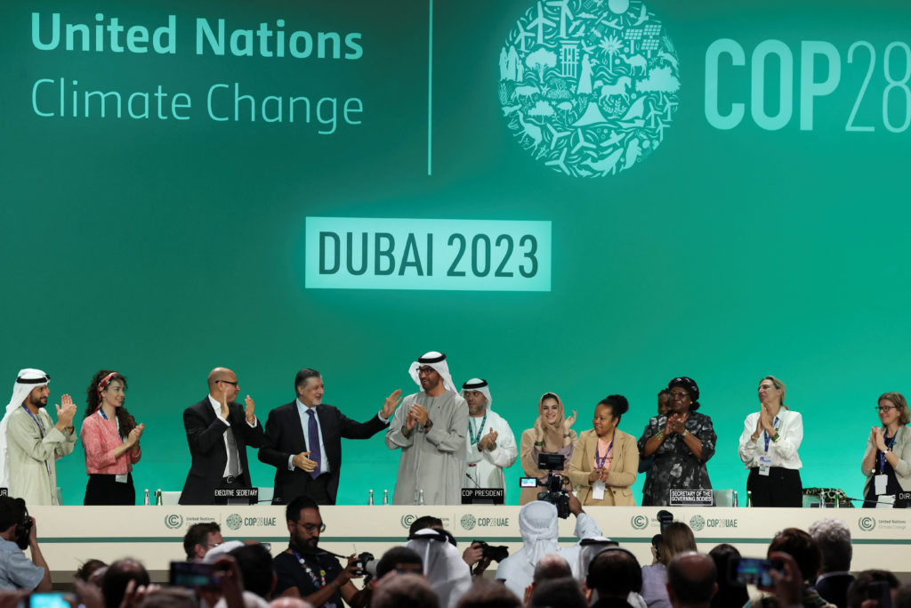
DUBAI CONSENSUS

Slide 3

CONTEXT
The Dubai Consensus, a significant resolution towards reducing fossil fuel dependency was adopted in COP 28, Dubai.
The deal calls for transitioning away from fossil fuels, but it does not go so far as to seek a phase-out of fossil fuels.

Slide 4
DUBAI CONSENSUS
KEY CLAUSE: The resolution emphasises transitioning away from fossil fuels to achieve net zero emissions by 2050, aligning with scientific recommendations to limit global temperature rise.
BALANCE BETWEEN COUNTRIES: The text reflects a compromise between developed and developing nations on climate action and responsibility.

Slide 5
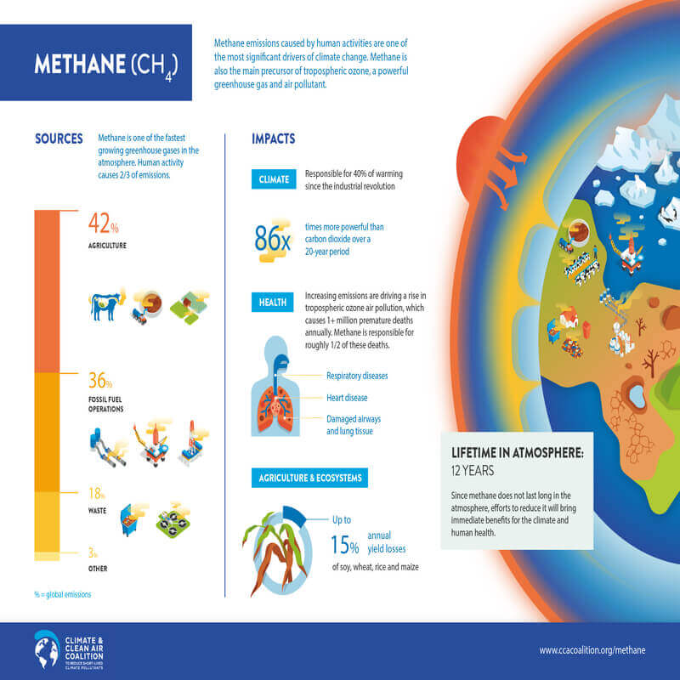
METHANE EMISSIONS: The COP28 for the first time brings in mention of methane, a non-carbon dioxide greenhouse gas that is more potent, in its heat trapping effect, than carbon dioxide.
COAL USAGE: The final text moderated its stance on coal, crucial for countries like India, calling for a phase-down rather than a rapid phase-out.

Slide 6
NATURAL GAS AS A ‘TRANSITION FUEL’: The text’s reference to natural gas as a transitional fuel could favor gas-producing countries and overlook the need for developed countries to close the finance gap in climate adaptation.

Slide 7
CHALLENGES IN FRONT OF INDIA
Net Zero by 2070: India has committed to achieving a net-zero state by 2070, alongside expanding its renewable energy capacity.
Fossil fuel transition and financial support: The Dubai Consensus calls for a transition away from fossil fuels, but the lack of stronger, binding commitments and firm financial support from developed nations poses a major challenge for India.

Slide 8
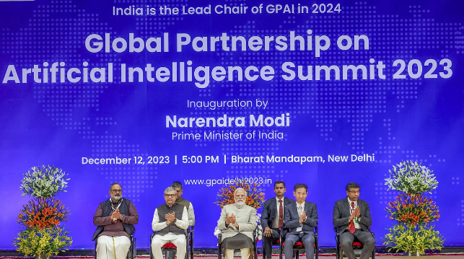
NEW DELHI DECLARATION ON ARTIFICIAL INTELLIGENCE

Slide 9
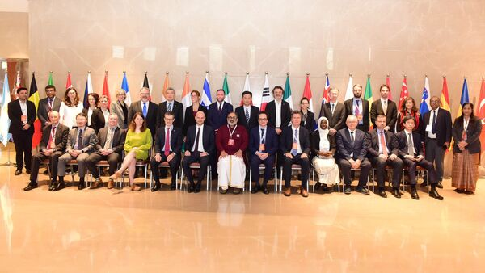
CONTEXT
The New Delhi Declaration on Artificial Intelligence was unanimously adopted by 28 countries at the Global Partnership on Artificial Intelligence (GPAI) summit held in New Delhi.

Slide 10

ABOUT THE DECLARATION
The declaration aims to direct the course of AI development, prioritizing the harnessing of opportunities while mitigating potential risks.
It also recognizes significant progress in strengthening GPAI as a diverse and inclusive group, and it positions GPAI as a leader in shaping AI.

Slide 11
The focus is on boosting innovation and collaboration to increase AI applications in critical areas such as healthcare and agriculture.

Slide 12
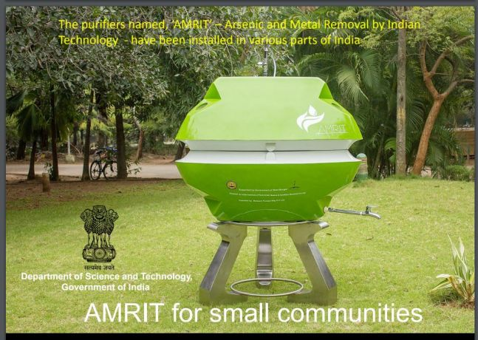
'AMRIT' TECHNOLOGY

Slide 13
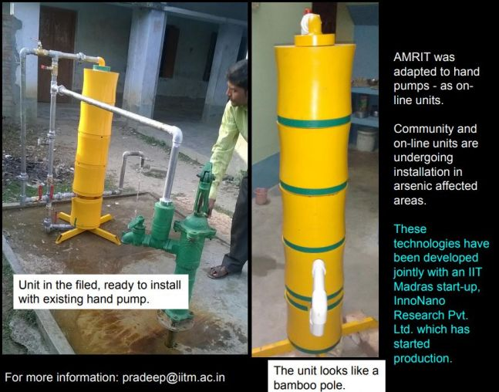
CONTEXT
IIT-Madras has developed an innovative technology named ‘AMRIT’ (Arsenic and Metal Removal by Indian Technology) aimed at eliminating arsenic and metal ions from water.

Slide 14
KEY FACTS
Key Mechanism: Employs nano-scale iron oxy-hydroxide for effective filtration.
Contribution to Public Health: The technology will help to achieve the goal of Government of India to provide safe water supply in adequate quantity, under Jal Jeevan Mission standards.

Slide 15
JAL JEEVAN MISSION OVERVIEW
Inception: Launched in 2019.
Implementing Body: Overseen by the Ministry of Jal Shakti.
Main Objective: Provision of Functional Tap Connection (FHTC) to every rural household by 2024.
Water Standards: Ensuring both the adequacy and quality of water supply.

Slide 16
CORE AREAS OF FOCUS
Recharge and reuse strategies for gray water.
Initiatives for conserving water resources.
Encouraging the practice of rainwater harvesting.

Slide 17
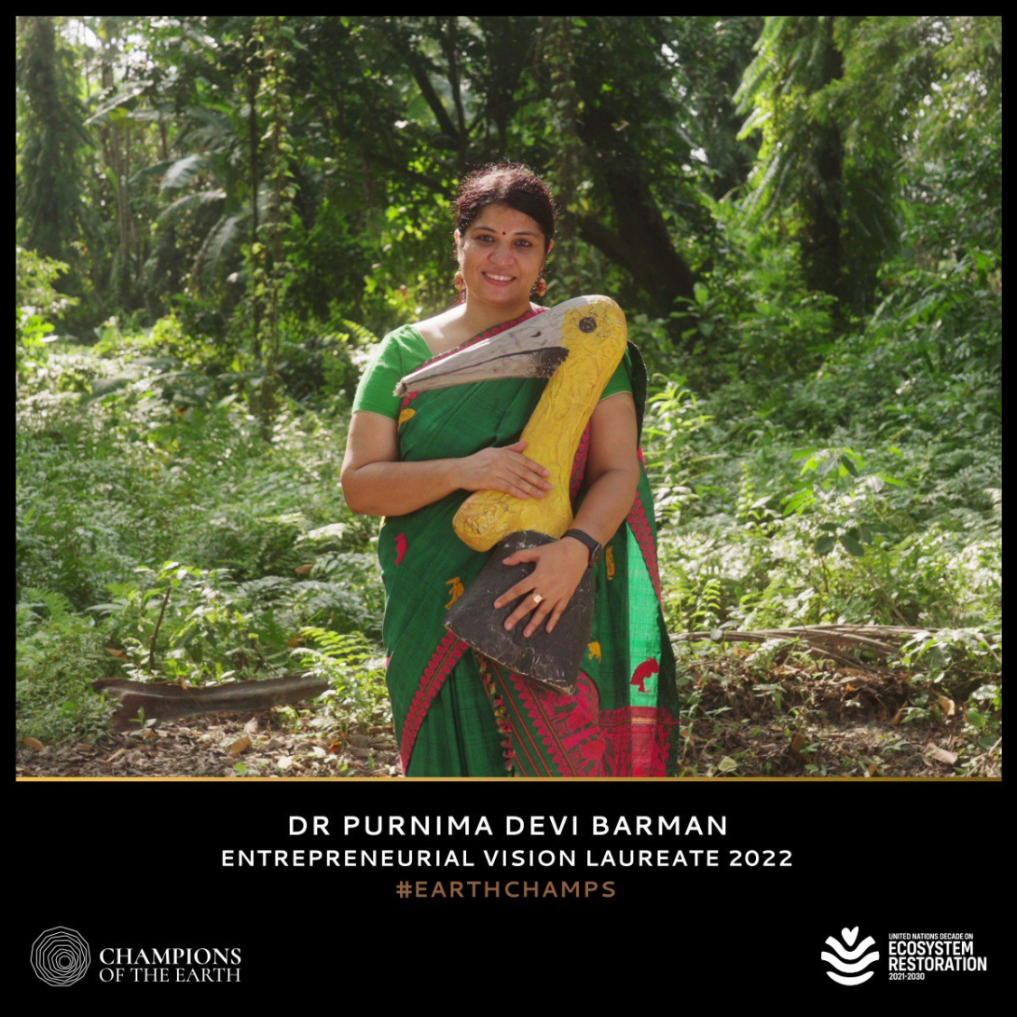
PURNIMA DEVI BARMAN

Slide 18
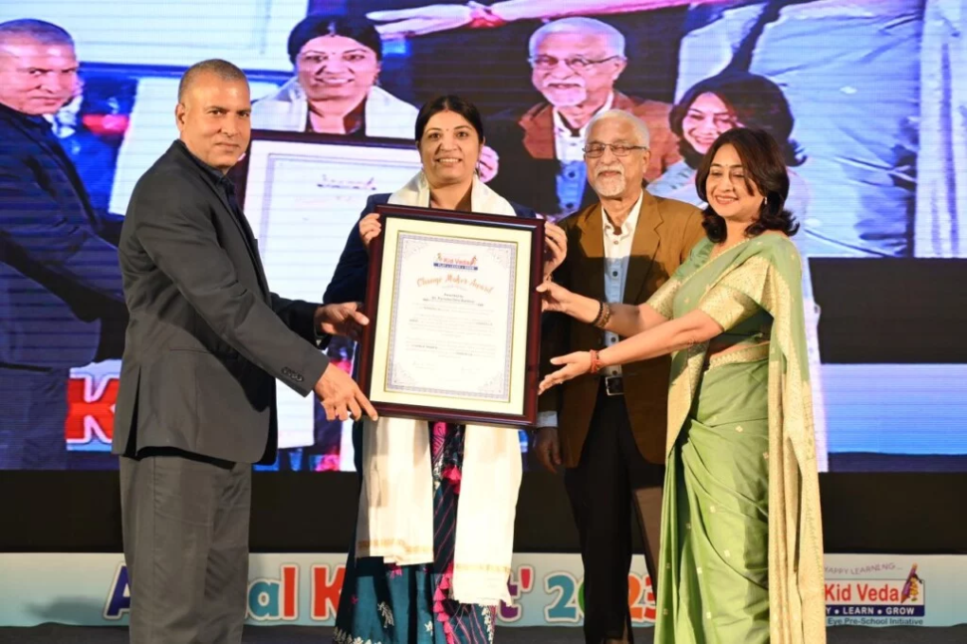
CONTEXT
Wildlife Scientist Dr Purnima Devi Barman Honoured With Kidveda Change Maker Award-2023

Slide 19
WHO IS DR PURNIMA DEVI BARMAN?
Dr. Purnima Devi Barman, a wildlife biologist from Assam, is renowned for her work in conserving the Greater Adjutant Stork, locally known as Hargila.
Dr. Barman was honored with the UNEP's 2022 Champions of the Earth award in the Entrepreneurial Vision category, the highest environmental honor given by the United Nations.

Slide 20
CONSERVATION LEADERSHIP
As a wildlife biologist, Dr. Barman leads the "Hargila Army," a unique all-female grassroots conservation group focused on saving the Greater Adjutant Stork, a species facing extinction.
:Since the initiation of her conservation program, the number of greater adjutant stork nests in certain areas of Kamrup District has increased dramatically, making it the largest breeding colony for this species globally.

Slide 21

SIGNIFICANT IMPACT
Dr. Barman's conservation efforts have led to the empowerment of thousands of women, transforming them into entrepreneurs and improving their livelihoods.

Slide 22
HUMAN-WILDLIFE CONFLICT RESOLUTION
Dr. Barman's work exemplifies how conflicts between humans and wildlife can be resolved for mutual benefit. She highlights the importance of protecting and restoring ecosystems, particularly wetlands crucial for the storks.

Slide 23
By the Officers,​
For the Officers

