Slide 1




MOST IMPORTANT TOPICS
KUDANKULAM NUCLEAR POWER PLANT GS-2, GS-3, PRELIMS, INTERVIEW
NAVAKANTA BARUAH GS-5, PRELIMS
THE ASSAM PRAKASHAN PARISHAD SAHITYA BOTA 2023 PRELIMS
FINANCIAL STABILITY REPORT, DECEMBER 2023 GS-3, PRELIMS

Slide 2
PRELIMS PRACTICE QUESTION
Q. Consider the following statements about Mission Karmayogi:
1. It is led by the Department of Personnel and Training, Government of India.
2. It is aimed at creating a competent civil service that is responsive to the needs of the citizens.
Select the correct answer from the code given below:
1 only
2 only
Both 1 and 2
None of the above

Slide 3
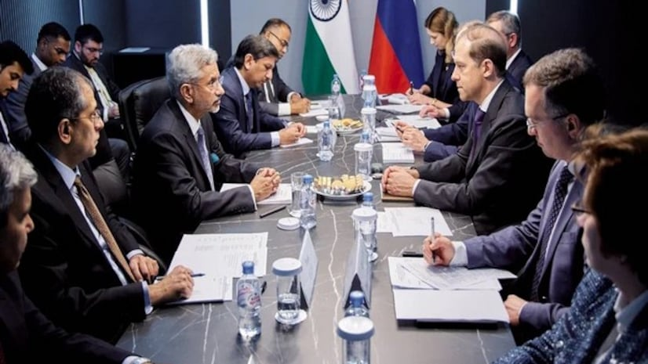
KUDANKULAM NUCLEAR POWER PLANT

Slide 4
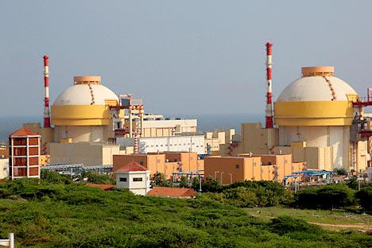
CONTEXT
India has signed agreements with Russia for future units of the Kudankulam Nuclear Power Project in the southern state of Tamil Nadu.

Slide 5
ABOUT KUDANKULAM NUCLEAR PLANT
Kudankulam is a town in the Tirunelveli district in Tamil Nadu, India, notable for the Kudankulam Nuclear Power Plant, which is the largest nuclear power station in India.
As of December 2023, the Kudankulam Nuclear Power Plant in Tamil Nadu, India has two operational units, with a combined capacity of 2,000 MW.

Slide 6
STRATEGIC INTERESTS
The Kudankulam Nuclear Power Plant is a long-term strategic project between India and Russia.
The project was originally proposed in 1988 as part of an Indo-Russian agreement, but it’s development was delayed due to the dissolution of the Soviet Union and subsequent leadership changes in both countries.

Slide 7
Construction of the first two units began in 2001 and they were commissioned in 2013 and 2016, respectively.
The project faced opposition and construction was halted at various points due to protests and safety concerns, including in the aftermath of the 2011 Fukushima nuclear disaster in Japan.

Slide 8
However, the construction resumed and the first two units are currently operational, with two more units under construction and two planned units.
The Kudankulam Nuclear Power Plant is a symbol of the growing partnership between India and Russia.

Slide 9
INDIA’S THREE STAGES NUCLEAR POWER PROGRAM
First stage: Pressurized Heavy Water Reactors (PHWRs) will be used to produce energy from natural uranium. They also produce fissile plutonium (Pu)-239.
Second stage: Using Fast Breeder Reactors fueled by Pu-239 to produce energy and more of Pu-239. Here, the reactor produces more fissile material than it consumes.
Third stage: Use of Pu-239 recovered from the second stage, in combination with thorium-232, to produce energy and U-233. U-233 would then be used as fuel.

Slide 10
URANIUM
Natural uranium as found in the Earth's crust is a mixture largely of two isotopes: uranium-238 (U-238), accounting for 99.3% and uranium-235 (U-235) about 0.7%.
Low Enriched Uranium contains a U-235 concentration between 0.711 percent and 20 percent and is used for energy production.
Highly Enriched Uranium contains a U-235 concentration greater than 20 percent and is used in naval propulsion reactors, nuclear weapons etc.

Slide 11
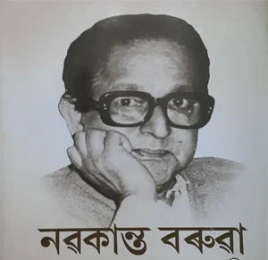
NAVAKANTA BARUAH

Slide 12
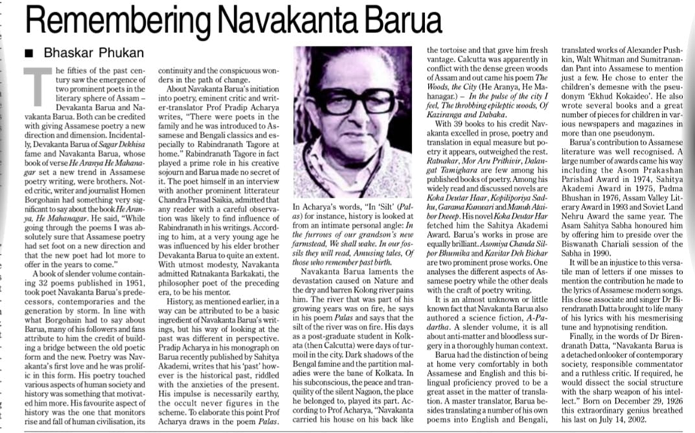
CONTEXT
During the 1950s, Devakanta Barua and Navakanta Barua transformed Assamese poetry, introducing new directions and dimensions in Assam's literary sphere.

Slide 13
BIOGRAPHICAL DETAILS
Early Life: Born on December 29, 1926, in Guwahati, Assam.
Education: Studied at Cotton College and Shantiniketan; completed M.A. from Aligarh Muslim University.

Slide 14
LITERARY CAREER
Emerged as a significant voice in modern Assamese poetry.
His writing style was deeply influenced by Rabindranath Tagore.
Translated renowned poets like Alexander Pushkin and Walt Whitman into Assamese.
Pseudonym for children's literature: 'Ekhud Kokaideo'.

Slide 15
MAJOR WORKS
Poetry: Known for collections like "Ratnakar", "Mor Aru Prithivir", "Dalangot Tamighara".
Novels: "Koka Deutar Har" (Sahitya Akademi Award), "Garama Kunwari", "Manuh Ataibor Dweep".
Essays: Explored the craft of poetry and Assamese poetic traditions.

Slide 16
AWARDS AND HONORS
1974: Assam Prakashan Parisod Award for Mur aru Prithibir
1975: Sahitya Akademi Award to Assamese Writers, for Kokadeutar Har
1976: Padma Bhushan, Literature & Education
1993: Assam Valley Literary Award
1998: Kamal Kumari National Award

Slide 17
LEGACY AND DEATH
Regarded as a pivotal figure in Assamese literature.
His works continue to influence and inspire contemporary Assamese writers and poets.
Passed away on July 14, 2002.

Slide 18
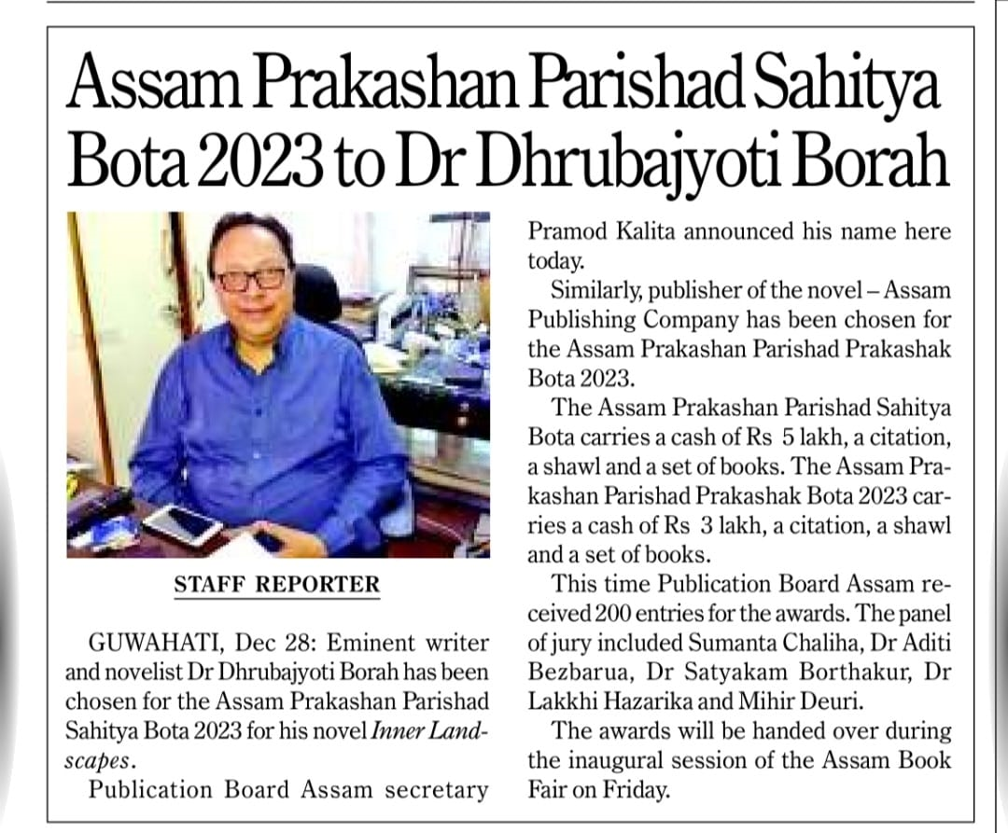
THE ASSAM PRAKASHAN PARISHAD SAHITYA BOTA 2023

Slide 19
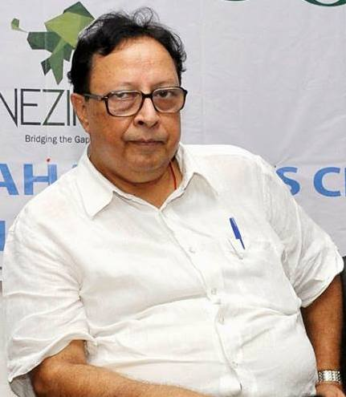
CONTEXT
The Assam Prakashan Parishad Sahitya Bota 2023 has been awarded to Dr. Dhrubajyoti Borah for his novel "Inner Landscapes".

Slide 20
KEY FACTS
Event: Presentation at Assam Book Fair's inaugural session.
Publisher Award: Assam Publishing Company, Assam Prakashan Parishad Prakashak Bota 2023.
Sahitya Bota - Rs 5 lakh, citation, shawl, books; Prakashak Bota - Rs 3 lakh, citation, shawl, books.

Slide 21

FINANCIAL STABILITY REPORT, DECEMBER 2023

Slide 22
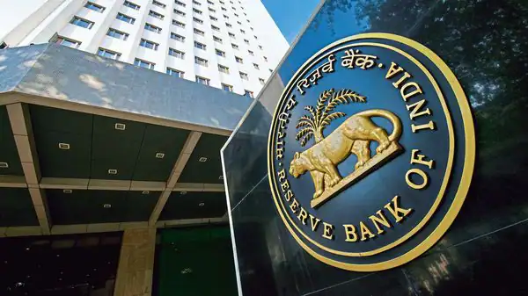
CONTEXT
The 28th issue of the Financial Stability Report (FSR) by the Reserve Bank, reflecting the Sub-Committee of the Financial Stability and Development Council's (FSDC) assessment of risks and resilience in the Indian financial system, was released

Slide 23
KEY POINTS
The global economy is confronting challenges like slowing growth, high public debt, increasing economic fragmentation, and ongoing geopolitical conflicts.
The Indian economy remains resilient, supported by strong macroeconomic fundamentals, robust financial institutions, moderating inflation, and improving external sector and fiscal positions.

Slide 24
By the Officers,​
For the Officers

