Slide 1


MOST IMPORTANT TOPICS
INNER LINE PERMIT (ILP) PRELIMS, GS-3
JONGAL BALAHU DIVAS PRELIMS, GS-5
REGISTERED UNRECOGNISED POLITICAL PARTIES (RUPPS) GS-2, PRELIMS
KERMAN CITY PRELIMS, GS-2

Slide 2
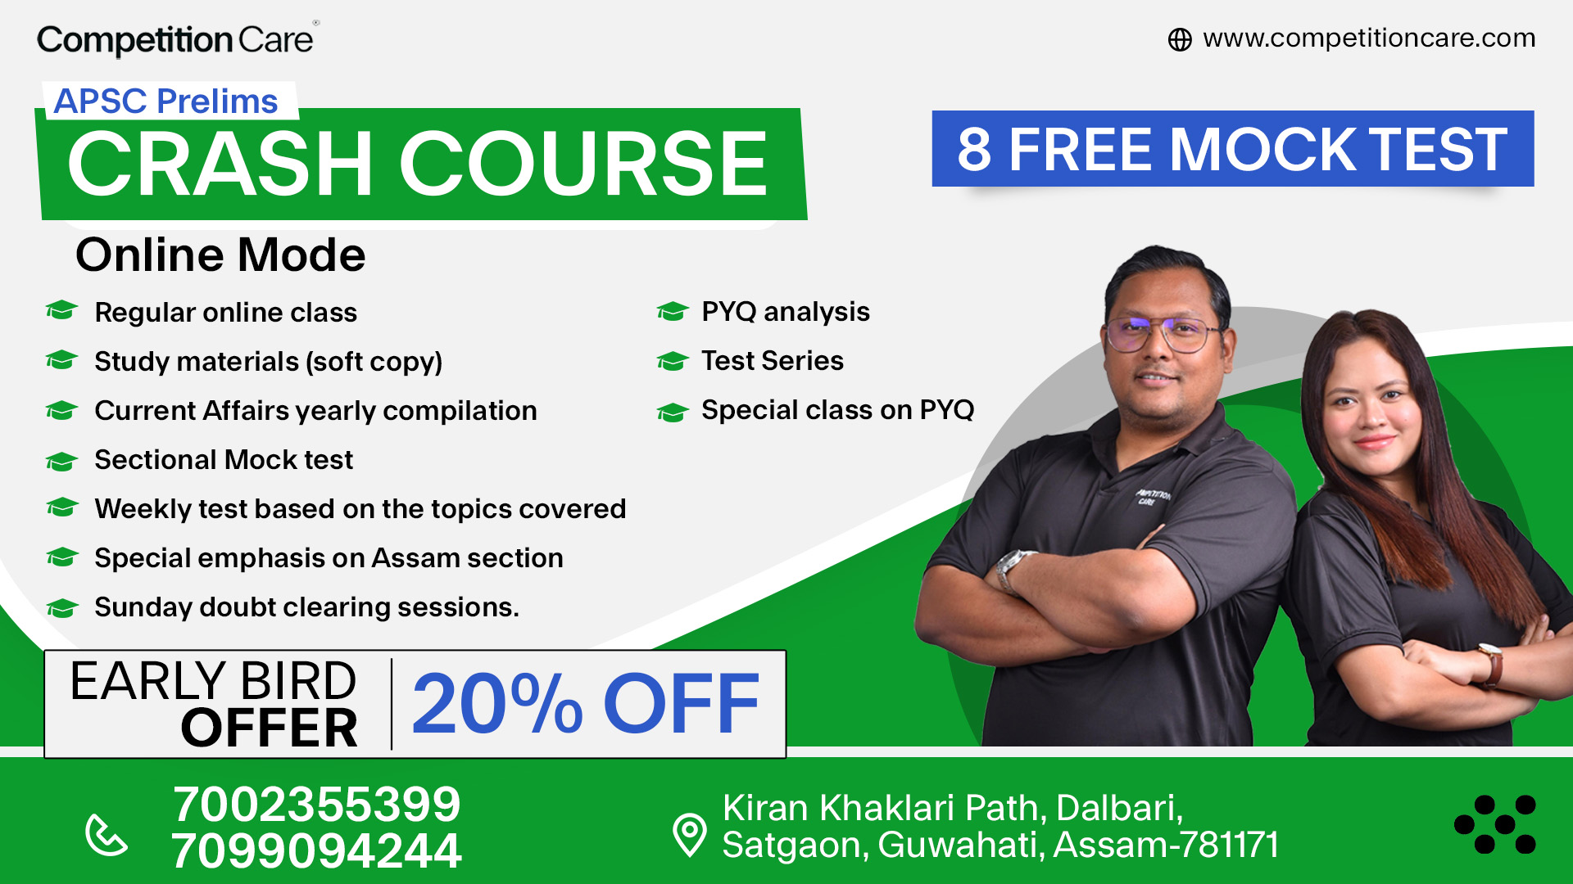
MOST IMPORTANT TOPICS
INNER LINE PERMIT (ILP) PRELIMS, GS-3
JONGAL BALAHU DIVAS PRELIMS, GS-5
REGISTERED UNRECOGNISED POLITICAL PARTIES (RUPPS) GS-2, PRELIMS
KERMAN CITY PRELIMS, GS-2

Slide 3
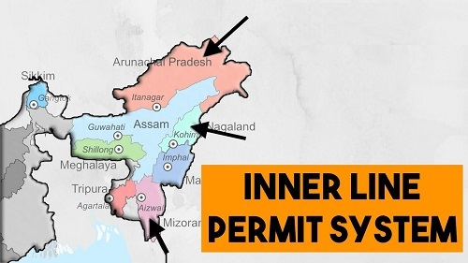
INNER LINE PERMIT (ILP)

Slide 4
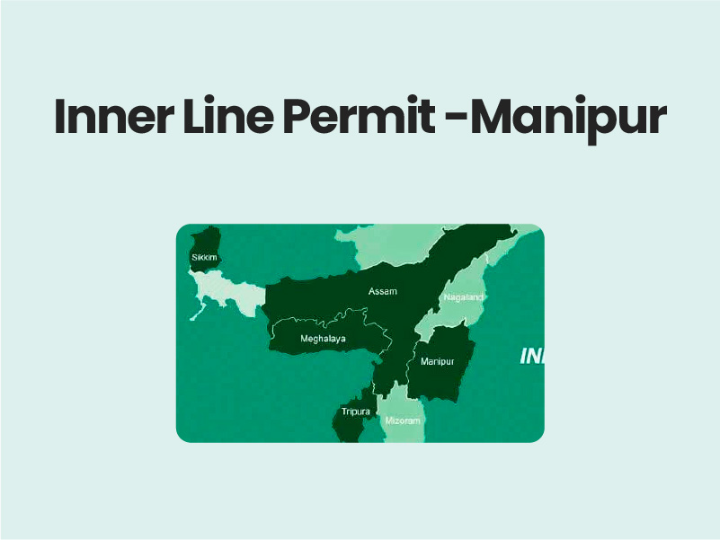
CONTEXT
The Prime Minister of India has asked the Chief Minister of Mizoram to submit a proposal regarding the Inner Line Permit system.

Slide 5
WHAT IS ILP?
Purpose: To regulate the entry of Indian citizens into protected areas for a limited duration.
Applicability: Primarily used in northeastern states (Arunachal Pradesh, Nagaland, Mizoram and Manipur) and some areas in Jammu and Kashmir, like Ladakh.

Slide 6
HISTORICAL CONTEXT
Introduced under the Bengal Eastern Frontier Regulation of 1873, initially to protect British commercial interests; post-independence, it shifted focus to safeguarding indigenous cultures and environments.

Slide 7
ADDITIONAL INFORMATION
Manipur Inclusion: In December 2020, Manipur was included in the ILP regime, making it the fourth northeastern state under this system.

Slide 8
PROCEDURE FOR OBTAINING ILP
Obtainable through government offices or online portals.
Required for domestic tourists; different regulations for foreign tourists, who usually need to register with local authorities.

Slide 9
IMPORTANCE OF ILP
Preserves distinct cultures and traditions of various regions.
Maintains demographic balance of tribal populations in the Northeast.
Controls illegal migration and encroachment in sensitive areas.

Slide 10
FUTURE OUTLOOK
While the ILP is a significant step in preserving the demographics and cultures of the Northeastern states, there's a consensus on the need for more robust and comprehensive solutions to enhance these protective measures.

Slide 11
PRELIMS PRACTICE QUESTION
Q. Consider the following statements with respect to Inner Line Permit (ILP).
1. Inner Line Permit is operational in Arunachal Pradesh, Mizoram and Nagaland.
2. It can be used for travel purposes only.
3.Visitors are not allowed to purchase property in these regions.
Which of the above statement/s is/are incorrect?
1 only
2 only
3 only
None of the above

Slide 12
MAINS PRACTICE QUESTION
Q. Analyse the issue of imposition of the ILP system in India’s northeastern states and the dilemma this system has posed to the Indian government.

Slide 13
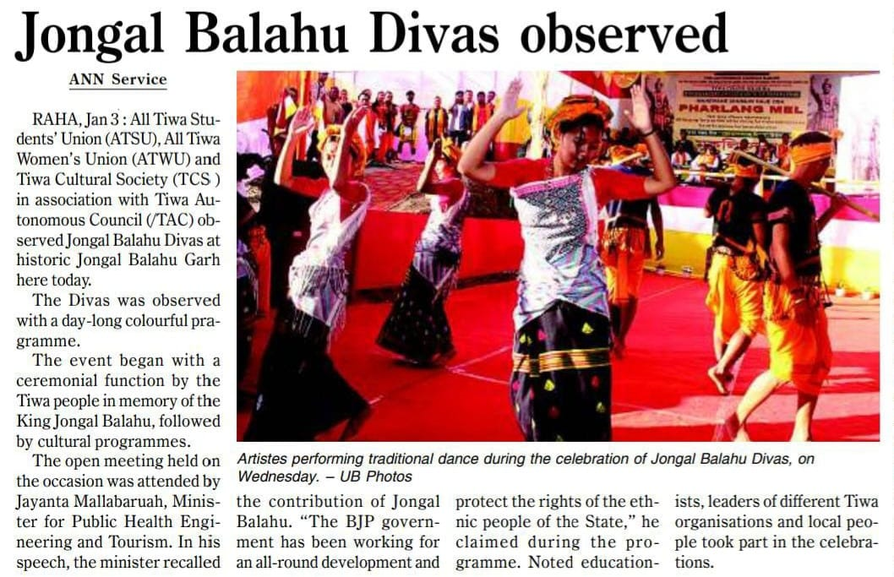
JONGAL BALAHU DIVAS

Slide 14
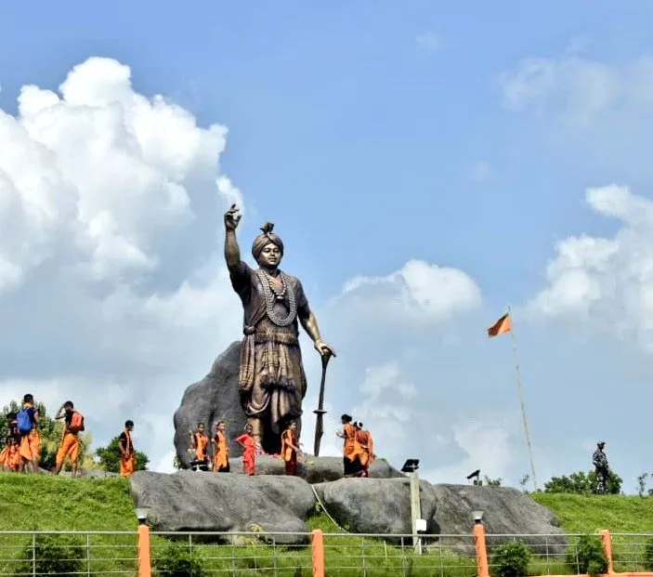
CONTEXT
The Jongal Balahu Divas was recently celebrated in Raha with great enthusiasm and cultural richness. This significant day is organized by various Tiwa community organizations.

Slide 15
ABOUT THE EVENT
The event commenced with a ceremonial function honoring King Jongal Balahu, an important figure in Tiwa history.
The day was marked by a series of cultural programs showcasing the rich heritage of the Tiwa people.

Slide 16
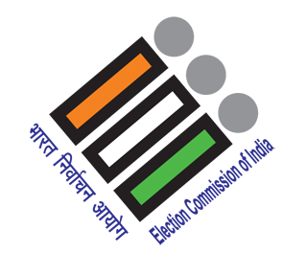
REGISTERED UNRECOGNISED POLITICAL PARTIES (RUPPS)

Slide 17
CONTEXT
The Election Commission of India has introduced new rules for the allocation of symbols to Registered Unrecognised Political Parties (RUPPs).
The new regulations aim to ensure due regulatory compliances by these parties.

Slide 18
The new regulations require RUPPs to furnish audited accounts, updated election expenditure statements and their latest organization details.
These details are now integrated into the application format for common symbols, aiming to streamline the process and enhance transparency.
The new rules came into effect from January 11, 2024.

Slide 19
ABOUT RUPP
These are political parties in India that are either newly registered, have not secured a sufficient percentage of votes in elections, or have never contested elections after registration.
Such parties do not enjoy all the benefits and privileges extended to the recognised parties by the Election Commission of India.

Slide 20
ECI allots symbols to political parties under the Election Symbols (Reservation and Allotment) Order, 1968.

Slide 21
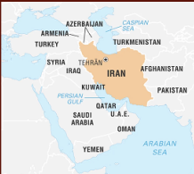
KERMAN CITY

Slide 22
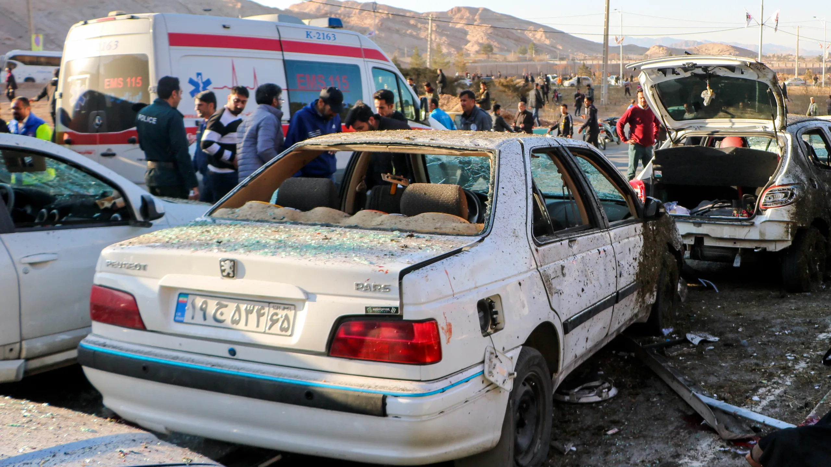
CONTEXT
India condemned the twin explosions that took place in Kerman city of Iran.

Slide 23
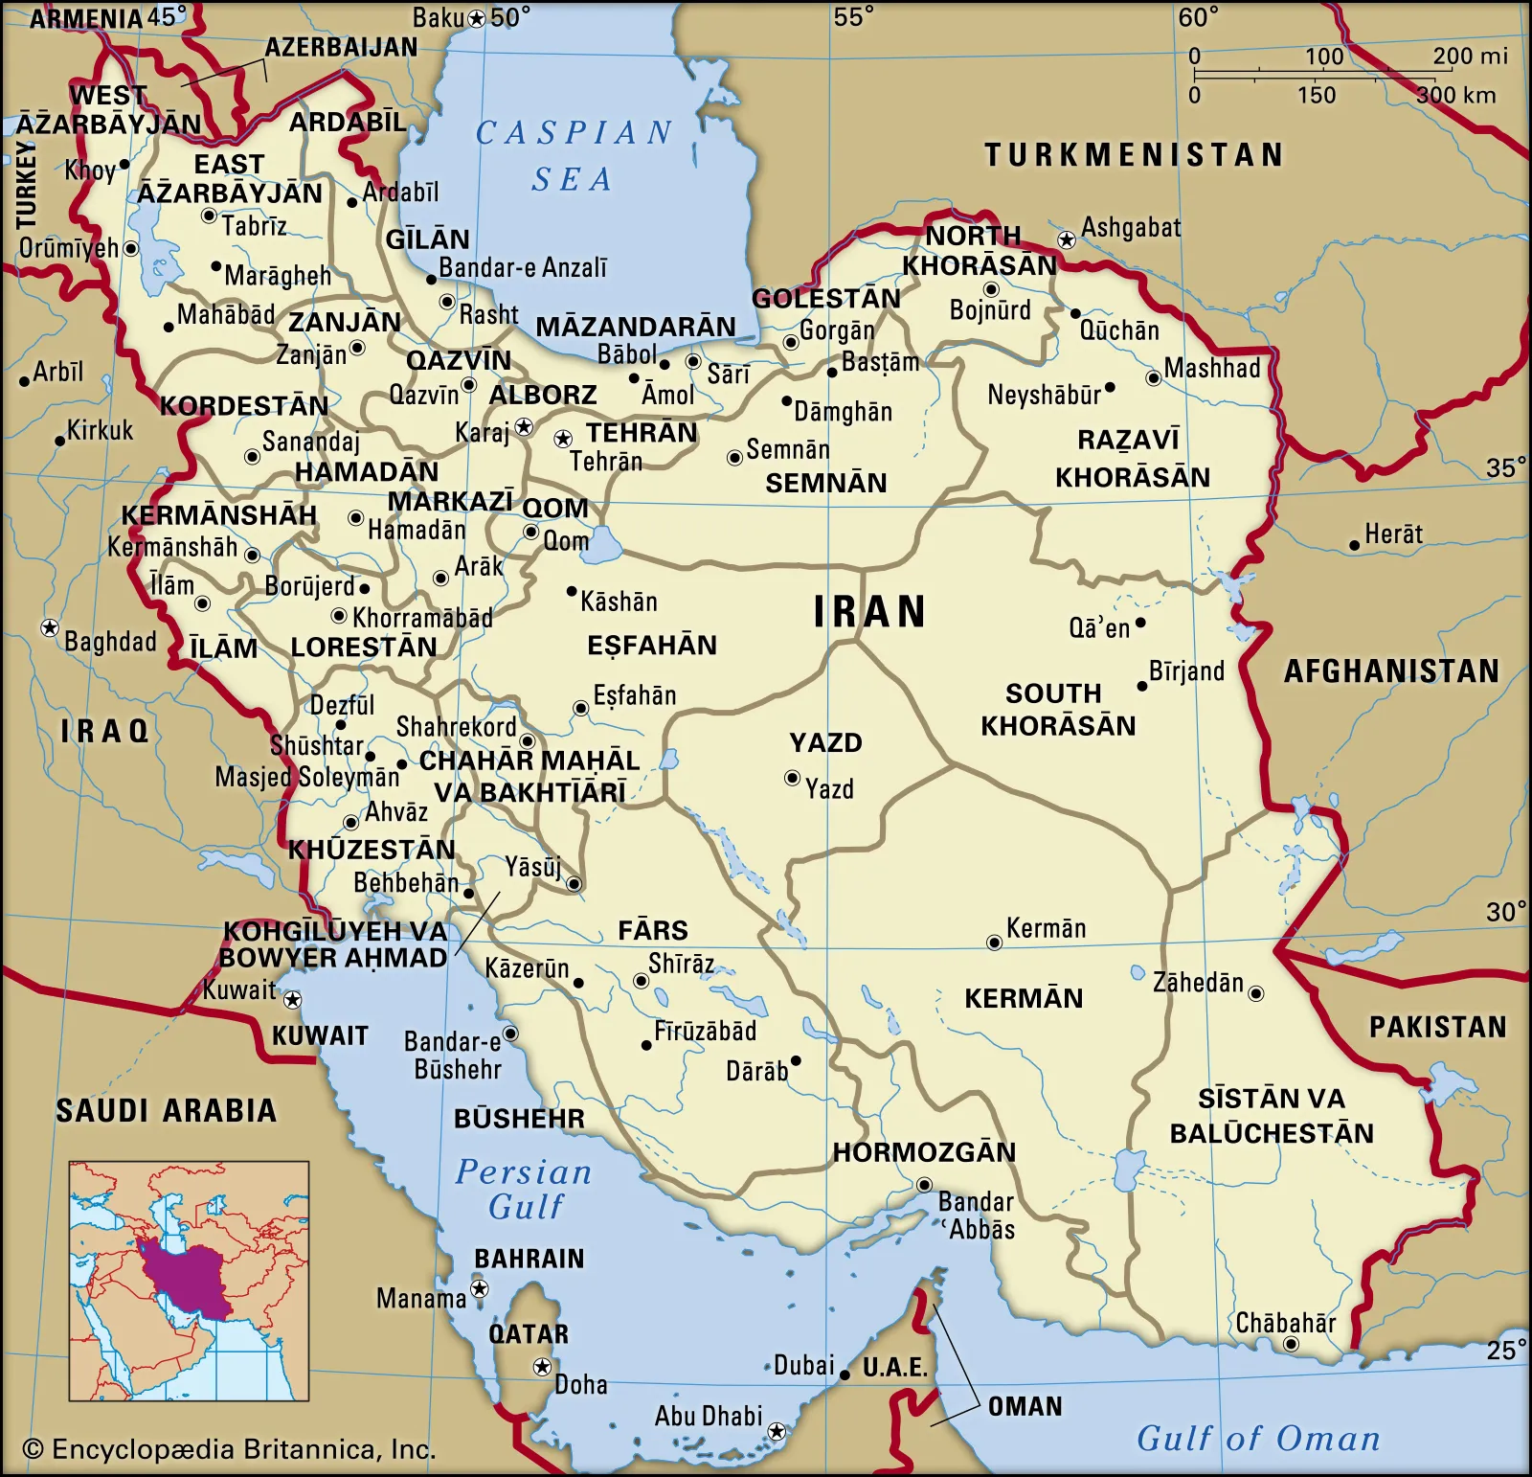
POLITICAL FEATURES OF IRAN
Iran is a country in the Middle East or West Asia.
Bordering nations: Afghanistan, Pakistan, Turkmenistan, Azerbaijan, Armenia, Turkey, Iraq.
Bordering water bodies: Caspian Sea, Gulf of Oman and Persian Gulf.

Slide 24
MAJOR AREAS OF COOPERATION WITH INDIA
Trade and economic cooperation: India and Iran have a history of strong economic ties, with India being among Iran's five largest trade partners in recent years. Major Indian exports to Iran include rice, tea, sugar, pharmaceuticals, manmade staple fibers, electrical machinery, and artificial jewelry, while Iran exports dry fruits, inorganic/organic chemicals, glassware, etc. to India.
Connectivity and infrastructure: India and Iran have Joint Working Groups to facilitate cooperation in various sectors, including connectivity. India has been closely cooperating with Iran in realizing the vision of Chabahar Port as a major trade relations hub.

Slide 25
Energy security: Iran is among the five largest suppliers of crude oil to India, supplying more than 425,000 barrels per day. India is one of the largest foreign investors in Iran's oil and gas industry.
Defense cooperation: India and Iran signed a defense cooperation agreement in December 2002.
Regional cooperation: India and Iran have a shared interest in regional security and stability, particularly in the Persian Gulf and Afghanistan. They have expressed support for the presence of NATO-led forces in Afghanistan

